Slide 1

Neuro-Evolutional Don’t Touch the Spikes with Erlang
By: Nadav Hadad & Tamir Cohen
Advisors: Yehuda Ben-Shimol & David Leon
Course: Functional Programming in Concurrent and Distributed Systems, Ben Gurion University.

Slide 2

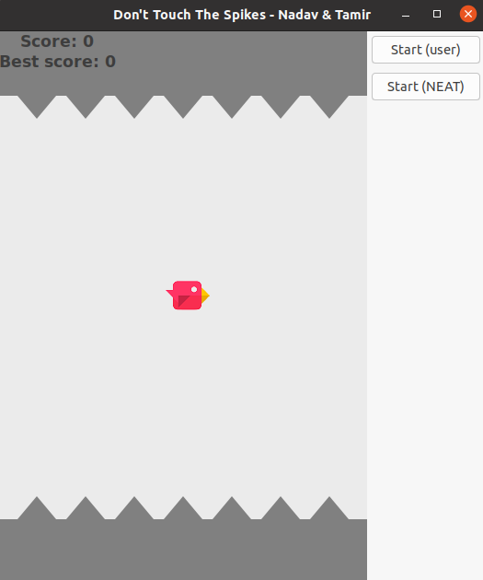
Main GUI

Slide 3

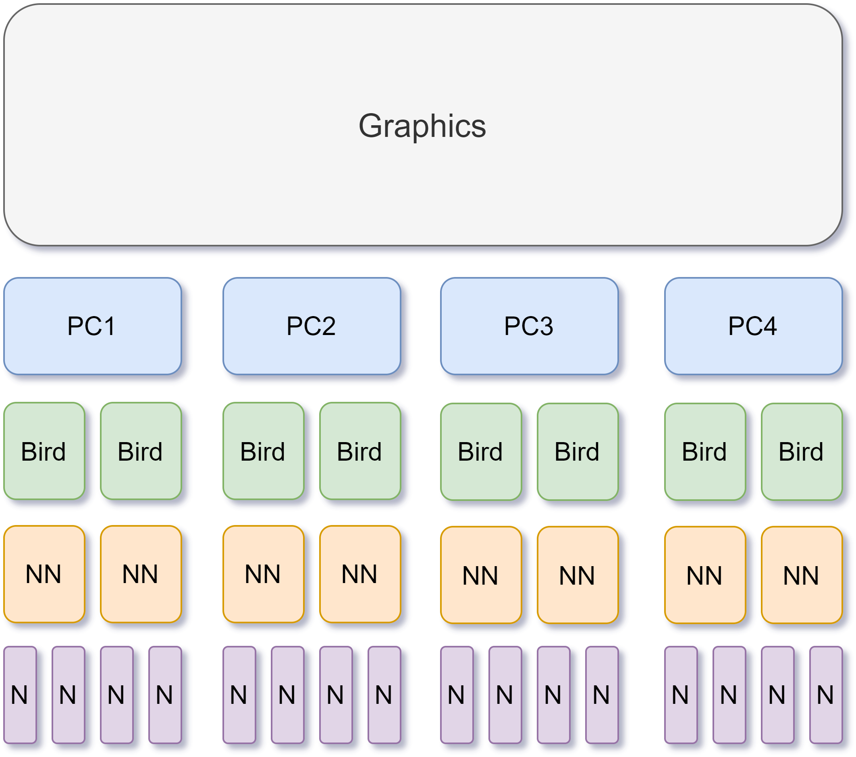
Project Layers & Design

Slide 4

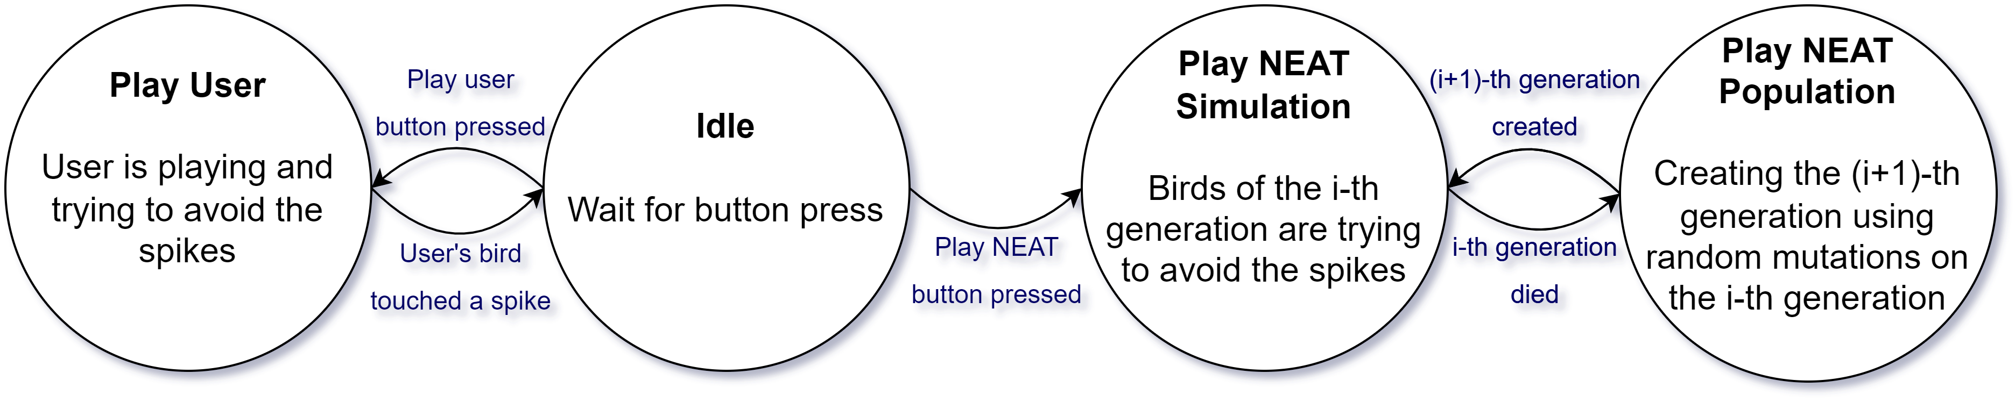
Graphics FSM

Slide 5
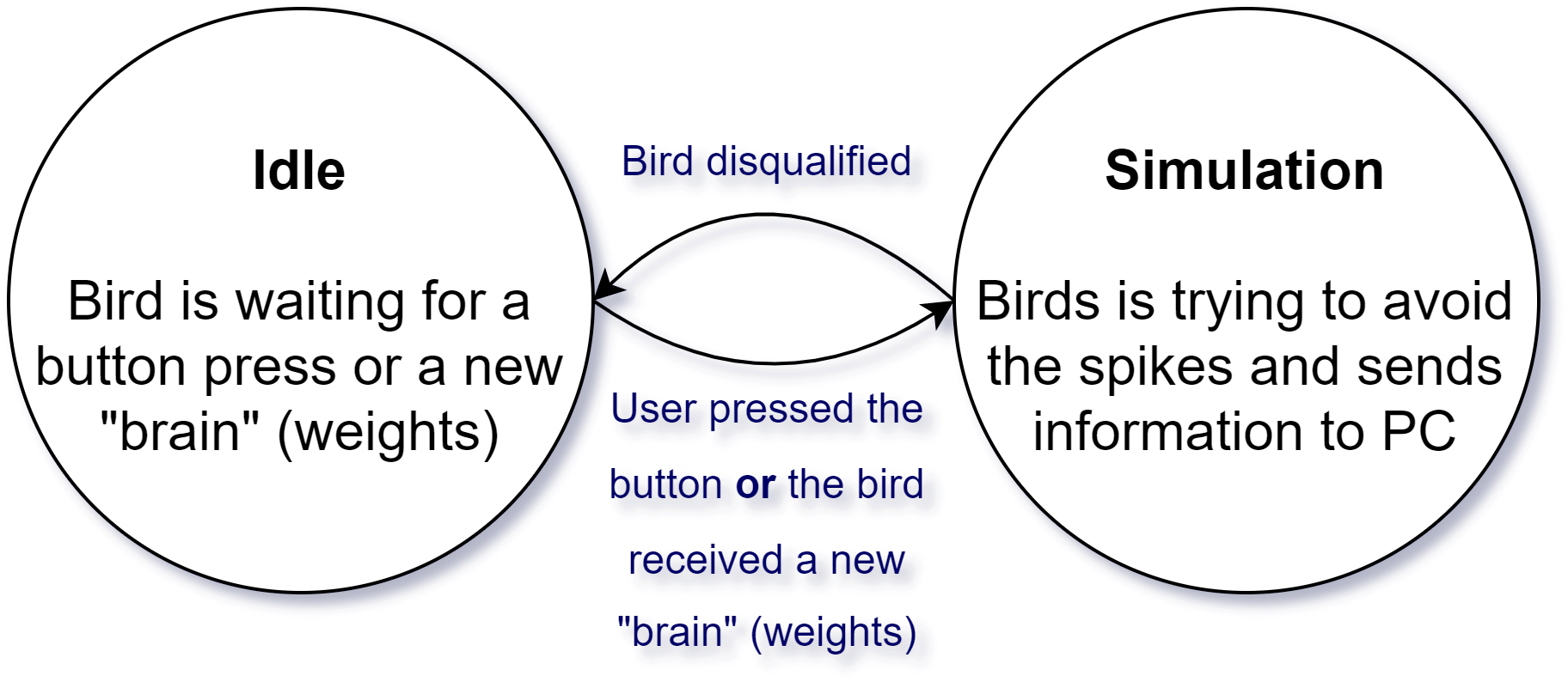
Bird FSM (User & NEAT)

Slide 6
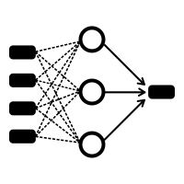
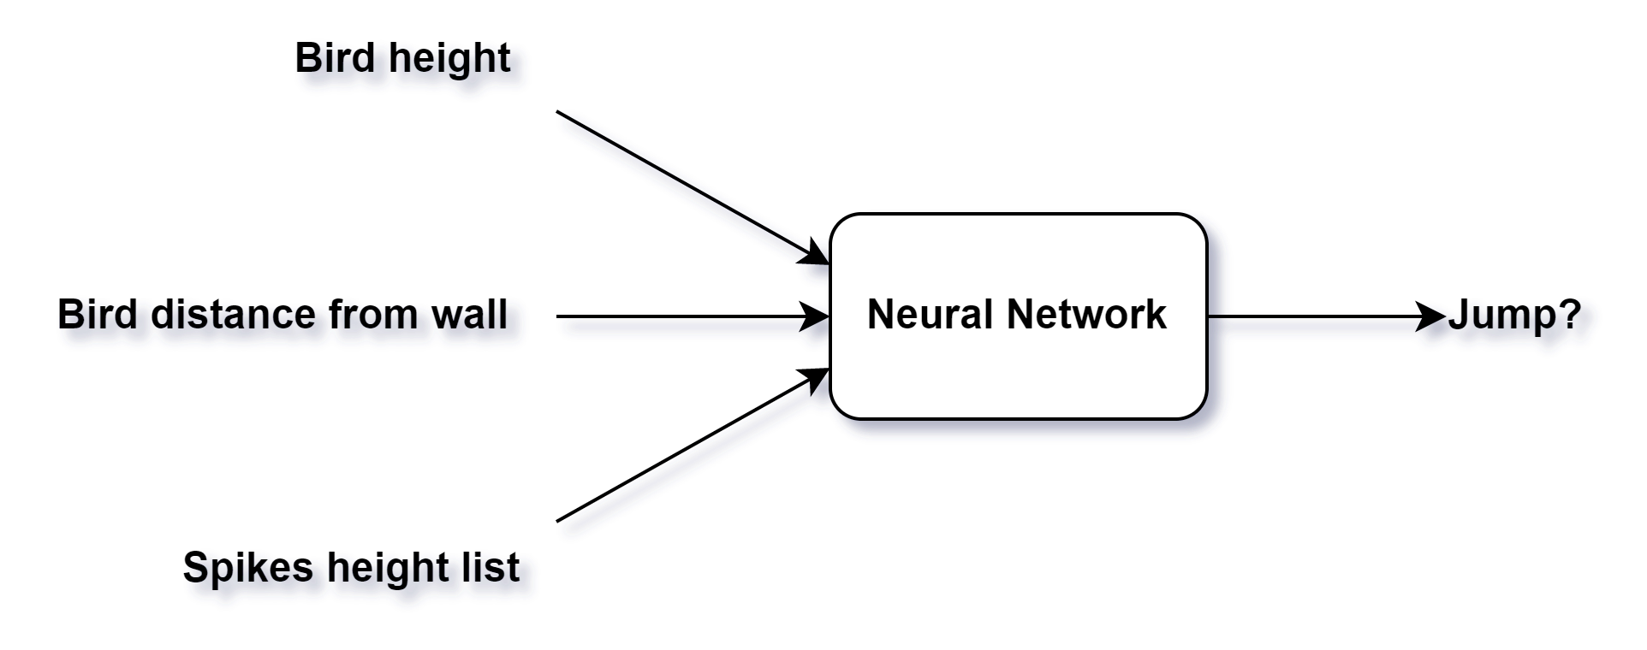
Neural Network (NN)
5 layers (9, 6, 6, 6, 1) 9 inputs and 1 output
relu activation function
20% survive each generation
(7 spikes)

Slide 7

PC Down
- The master (the graphics module) sends ‘are_you_alive’ message to all PCs every 0.5 seconds.
- Each PC responds to this message with ‘im_alive’ message.
- The master marks as alive PCs only the computers that send him ‘im_alive’, and the others are dead.
- The master splits the work between the alive PCs only.

Slide 8

Problems & Solutions
- Replace a bird’s “brain” (weight list). Each weight in the NN is stored in the NN’s map. The keys of this map are the PIDs of the two neurons sharing this weight. Each bird replaces its brain with another one, but how should it know which weight to put where, if the PIDs are different among different birds? We decided to number the weights and send them to the master in sorted order. Then, each bird receiving a brain knows exactly how to store it in its map.
- Slow system The whole system worked slow. We decided to speed it up using several ways: - Send only the Y locations to the graphics, while the X location is synced among all birds. - Don’t ask the NN whether to jump in each frame. - Don’t send the spikes list to the NN each frame, but only in each wall touch.
- Run on lab’s computers ☹. Our Erlang OTP is 25 and the lab’s computers have 24.

Slide 9

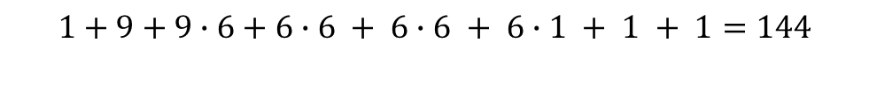
Statistics 1
- We verified that the number of messages per single frame time in the system is¹:
$4+400+400+400=1204$
- If a bird asks its NN whether to jump, we will add to the number of messages (for 1 bird):
¹ Number of birds is 400 (100 per PC). ² Optional message.
Simulate frame (graphics to PC)
Simulate frame (PC to birds)
Bird sends location or disqualified (bird to PC)
PC sends location or disqualified (PC to graphics)
$$1+9+9∙6+6∙6 + 6∙6 + 6∙1 + 1 + 1=144$$
Ask NN to decide whether to jump (bird to NN)
Feeding the input layer (NN to neurons)
Neurons messages -Feed Forward (neuron to neuron)
Send to NN the answer (neuron to NN)
NN tells the bird to jump² (only if needed)

Slide 10
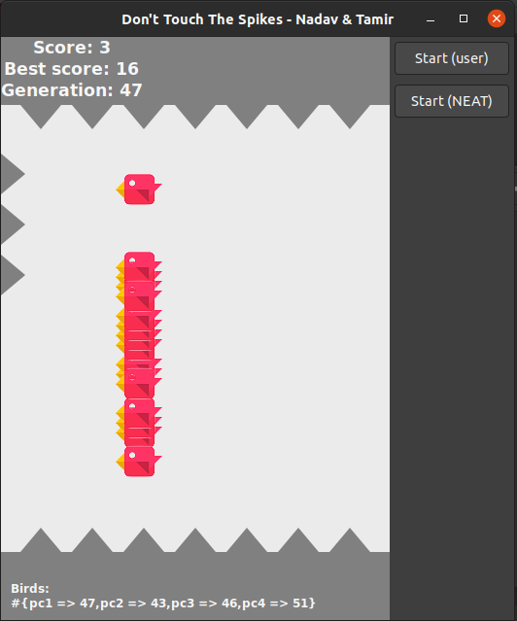
Statistics 2
- We also display the number of alive birds per PC:

Slide 11
Thank you for listening!

